Slide 1
Mantid Scientific Steering Committee
Nick Draper
14/12/2009

Slide 2
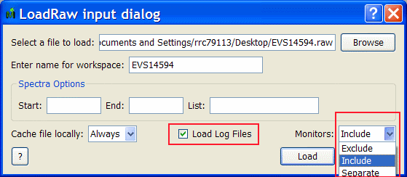
Progress over the last iteration
Python and Mantid training
  Developed a ½ day Python Course
  Rerun existing Mantid scripting course
  Completed 2 sessions, 20 attendees
LoadRaw
  Log files can now be ignored
  Control of Monitors
    Exclude – don’t load
    Include – as previously
    Separate – Load into a seperate workspace

Slide 3
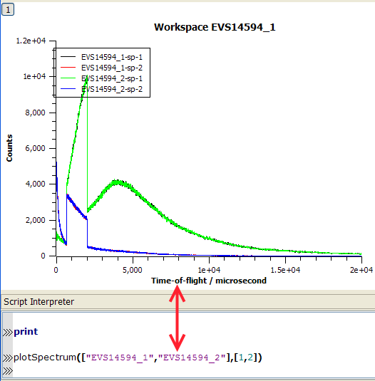
Progress over the last iteration
Scripting changes
  Improved syntax for multiple graphs: plotSpectrum
  Easier to listing workspaces: mtd.list()
  Easier to access workspaces: w1=mtd[`bob`]
    Also extract workspaces from algorithms
      alg=LoadRaw('GEM38370.raw','workspace')
      w1=alg[0]
  Workspace Algebra: a=b*c/(2+d)
  Use workspace directly in Algorithm calls
    GetEi(W1,0,1,15.0)

Slide 4
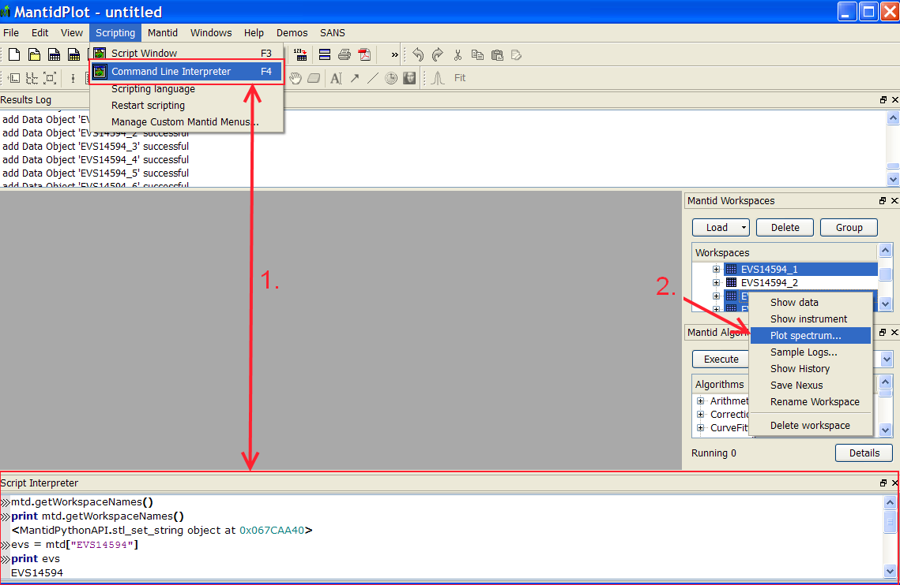
Progress over the last iteration
User Interface
  New python script Immediate window
  Much easier to plot data from several workspaces
    Groups / multiple selection
    Drag and drop
    Multiple selection within a workspace
    Errors
  File menu: Loading and saving
  Mantid Projects
  Getting you selection stuck in the graph has been resolved

Slide 5
Progress over the last iteration
SANS
  SANS reduction routines accessible via python for batch processing
  Gravity Correction
  Fixed several bugs with SANS beam centre finding
Reflectometers
  PowerLawCorrection: donated by Rob Dalgliesh
  Peak fitting routines now output a covariance matrix
Excitations
  GetEI: Calculates the Incident Energy for a workspace
  SaveSPE: Outputs data in the SPE format
  DetectorEfficiencyCorrection: for cylindrical detectors
  Core Homer script under evaluation

Slide 6
Progress over the last iteration
Muons
  LoadMuonNexus: Improved group handling.
  MuonAysmmetryCalc: F and B groups or individual spectra.
  PlotAssymetrybyLogValue: F and B groups can be defined.
Crystallography
  SplineBackground: A new algorithm to map a spline through your data, and regions masked with MaskBins will be ignored when generating the spline.
Molecular Spectroscopy
  DASC / SPE File support
  FFTSmooth: Data smoothing an FFT technique.

Slide 7
Progress over the last iteration
Installation
  Solved some installation side effects with other Python packages
Performance
  Memory management improvements to both Windows and Linux environments
  Compressed workspaces
  Load/save Nexus files
    Now on a par with Raw files, may be faster over a network.
Outreach
  SNS collaboration agreement discussions continuing
  December: Robert MacGreevey -> SNS
  January: Nick Draper -> SNS

Slide 8
Next release headline items
Curve fitting improvements
  Simultaneous fitting of multiple curve and background functions
  Fixed, tied and constrained parameters
  Choice of function minimiser
  Improved user interface integration
Python Algorithms
  Much easier user extension of Mantid

Slide 9
Next release headline items
Further integration with Mantidplot user interface
Improved automated system testing
Excitations Homer user interface
Muon Nexus version 2 support
CanSAS file format support
Completion of Short Term goals

